Slide 1
Hello speakhire

Slide 2
Robert’s AGENDA
Tasks
Challenges
Takeaways

Slide 3
tasks

Slide 4
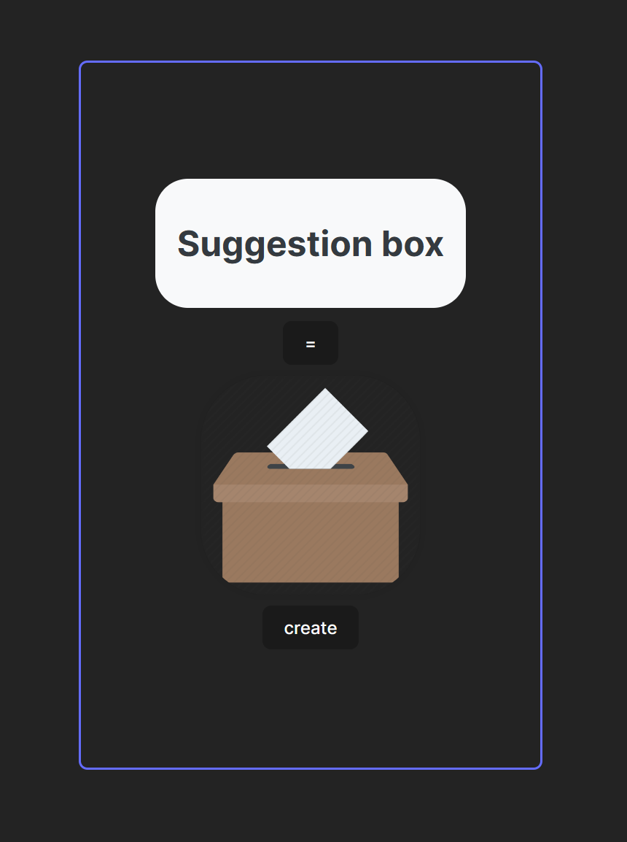


Assessment and exploration

Slide 5
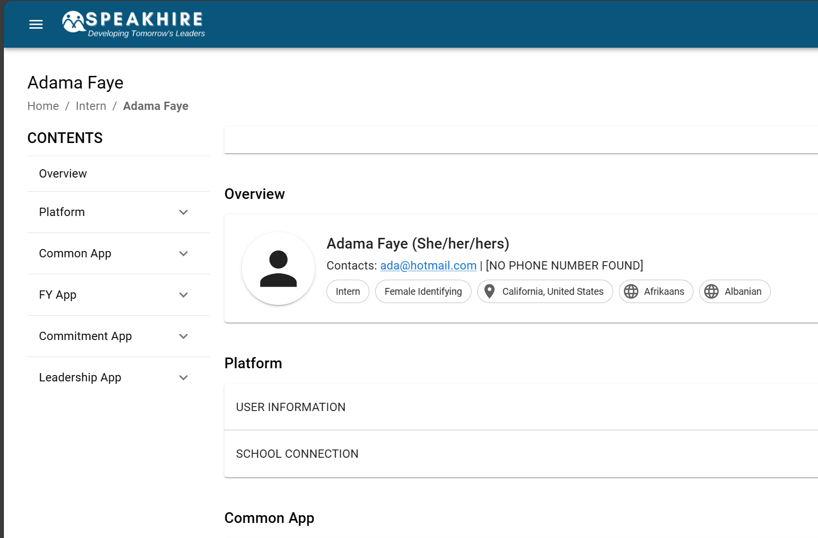
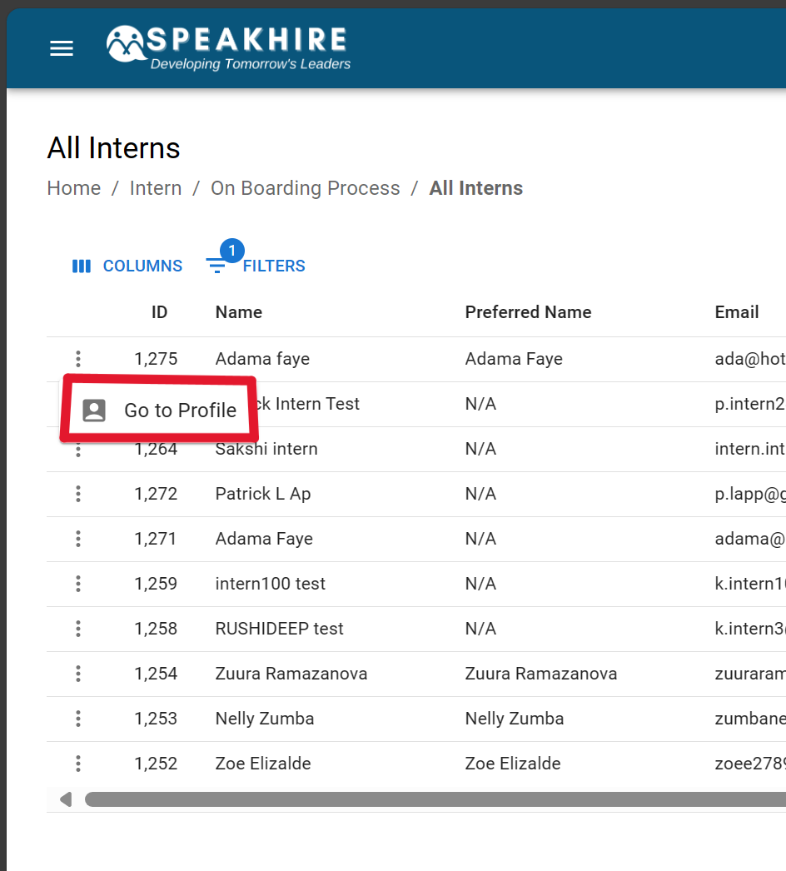
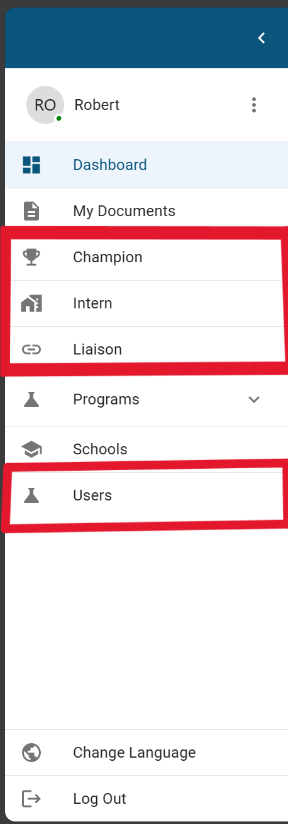

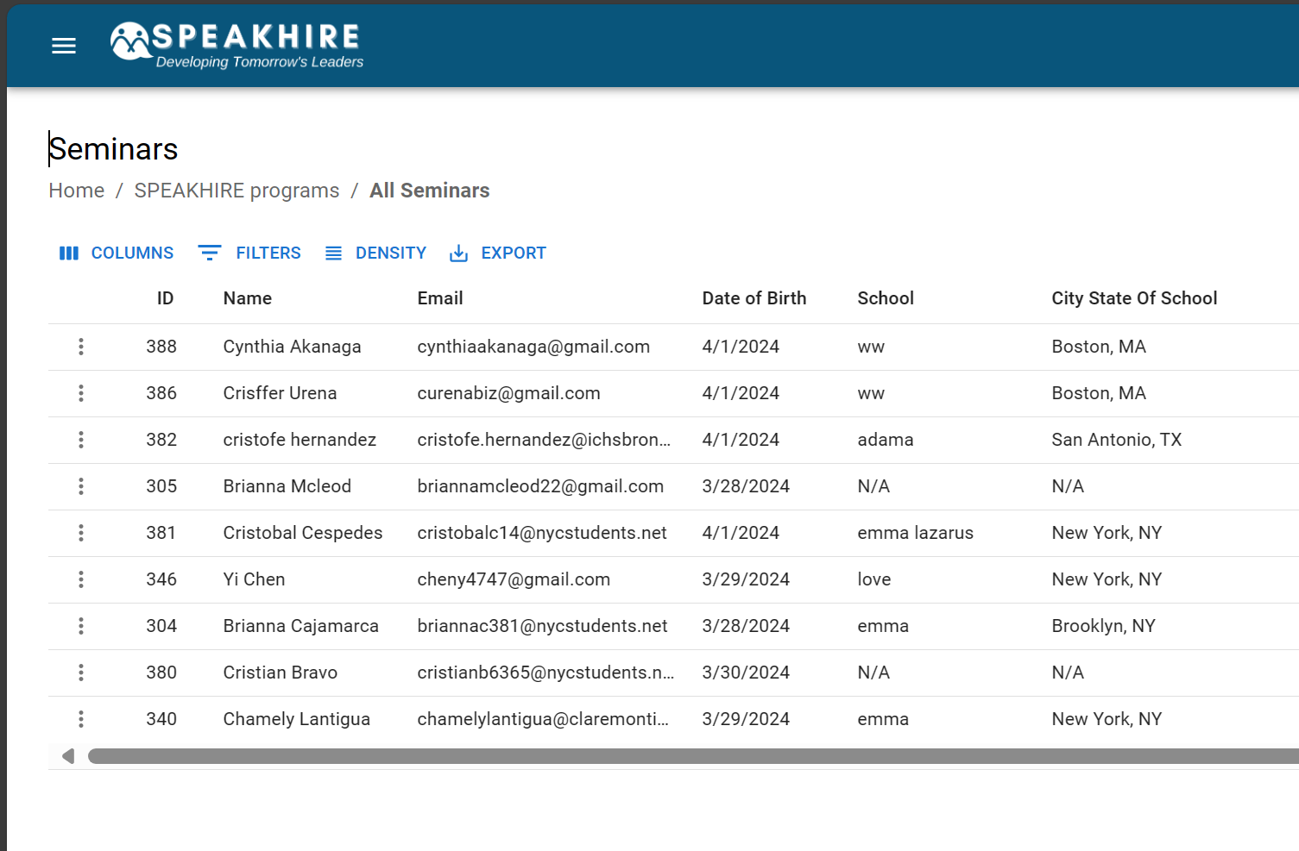
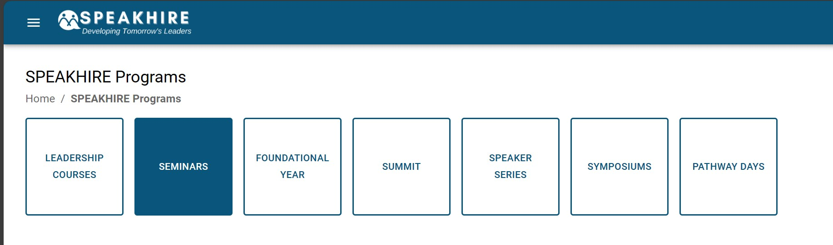
NAVIGATION
task1
task2

Slide 6
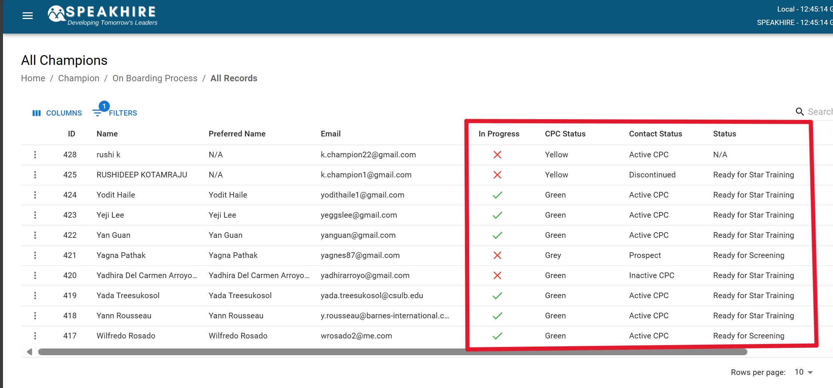

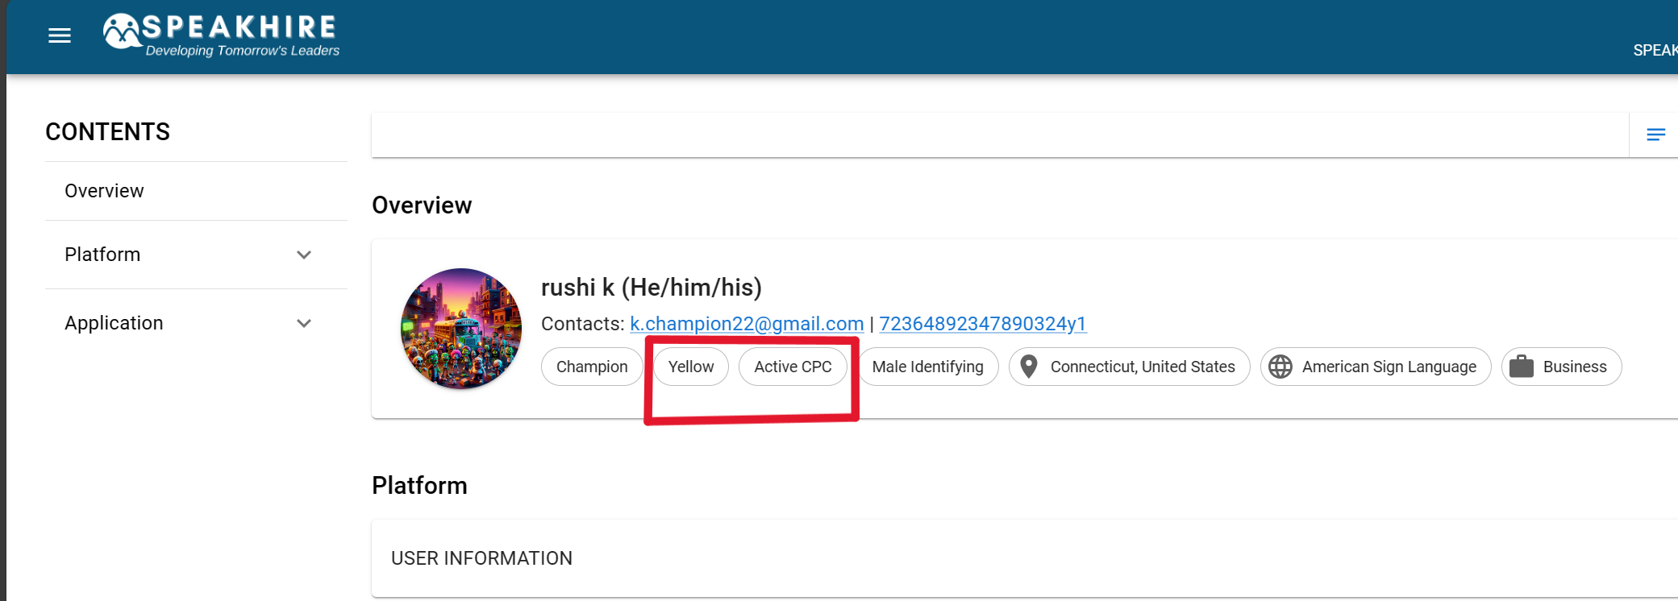
display
task1
task2
task3

Slide 7
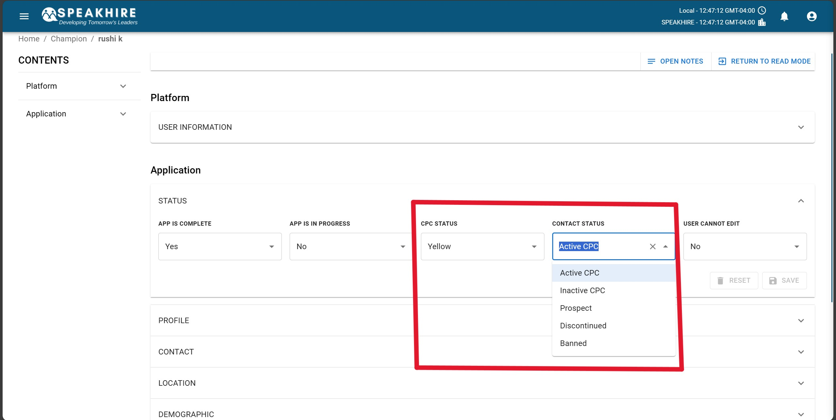
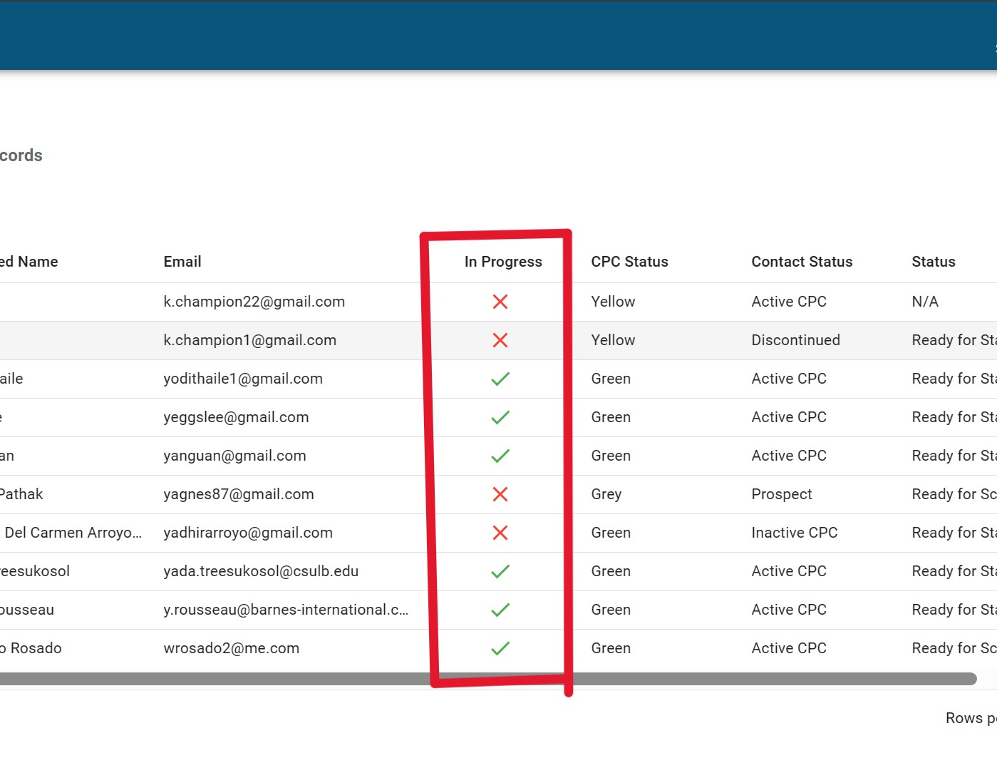

dynamic
task1
task2

Slide 8
Challenges

Slide 9

That’s a lot of code

Slide 10
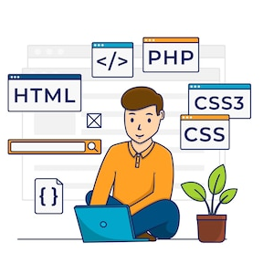
New Languages/tools

Slide 11

Connecting the pieces

Slide 12
takeaways

Slide 13

Level up my dev skills

Slide 14

Balance of asking questions

Slide 15

Component thinking to big picture

Slide 16

All learning and growing

Slide 17
return 0;

